Slide 1
How to build Meta Communication Library
2021-02-19

Slide 2
Overview
MtCL: Meta Communication Library
Directly communicate to robots (ex. Dobot, Janome, Techman)
Integrable: Provide interface and UI to control robots.
Extendable: Apply “Abstract Factory” mechanism.

Slide 3
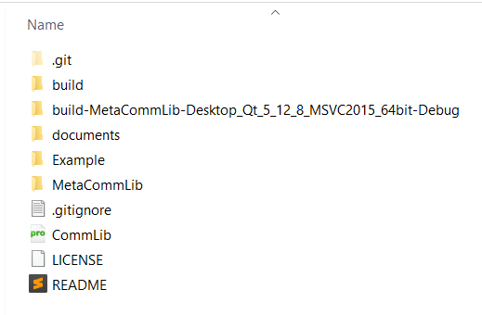
Overview
GIT: https://github.com/ngbtrung2904/MetaCommunicationLib.git
Folder structure
MetaCommLib: source code
Example: test projects
Documents: Documents about library

Slide 4
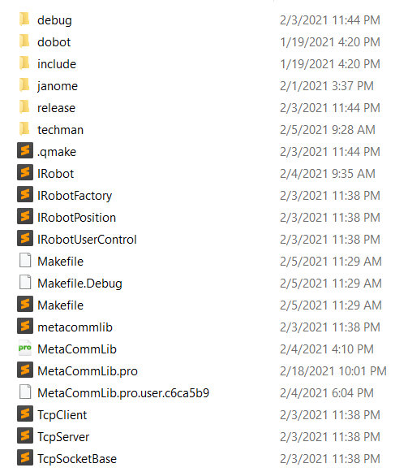
Overview
Dobot: implementation of Dobot
Janome: implementation of Janome
Techman: implementation of Techman
Common interfaces: IRobot (control robots); IRobotFactory (instantiate robots) and IRobotUserControl (default UI to control robot)

Slide 5
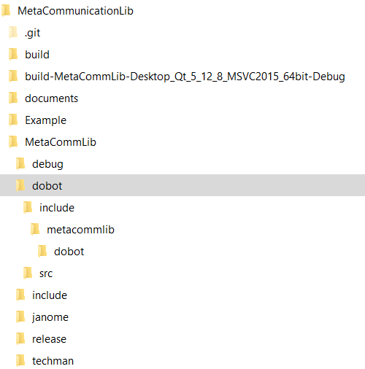
Overview
Each instance of robot includes:
src: source code files (*.cpp)
./include/metacommlib/dobot: headers file (*.h or *.hpp)

Slide 6
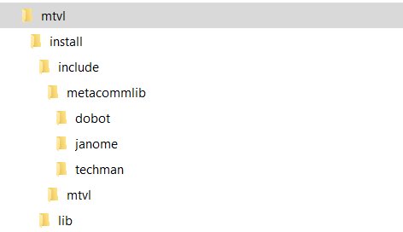
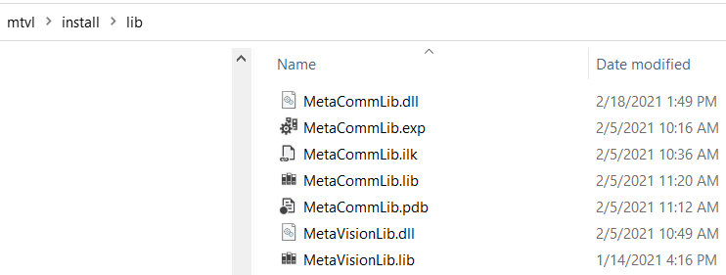
Overview
MtCL automatically installed in pre-defined folder (by MTVL_INSTALL variable)
All headers file copied to specific folder and library files copied to “lib” folder.

Slide 7
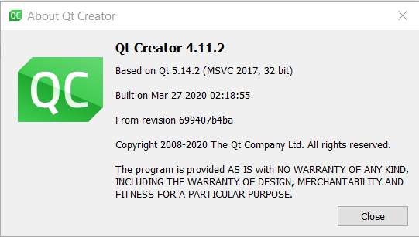
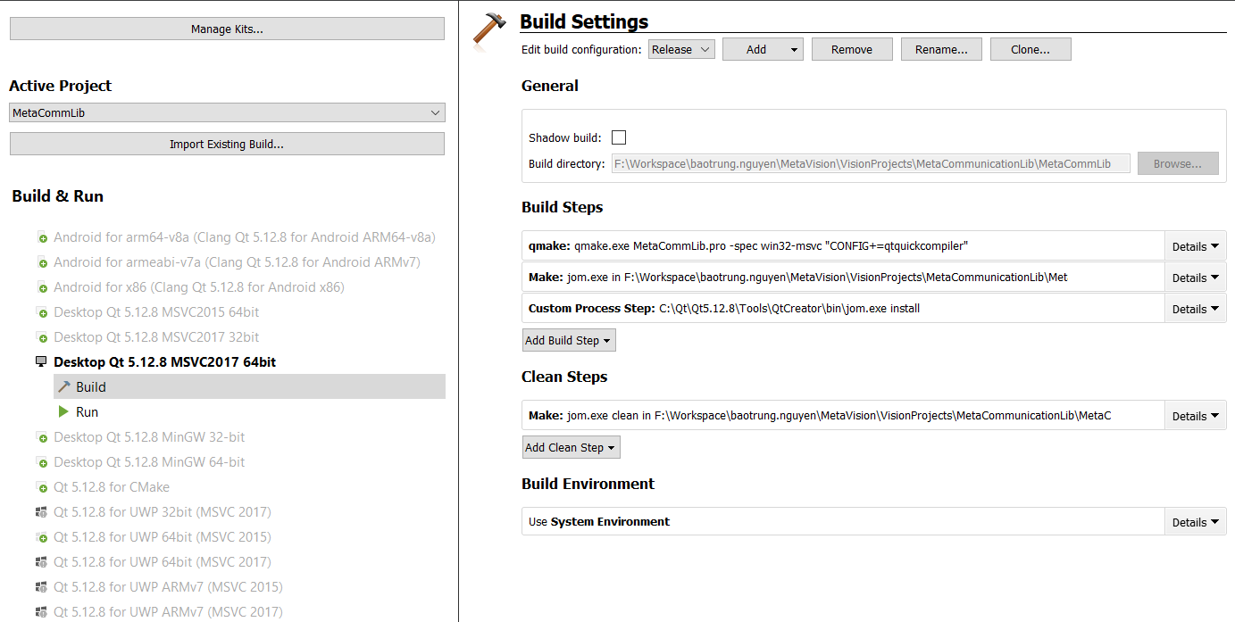
How to build
Version of Qt
Qt Creator 4.11.2
Based on Qt 5.14.2
Configure MetaCommLib project
Release Mode
Add custom process step (to install library)

Slide 8
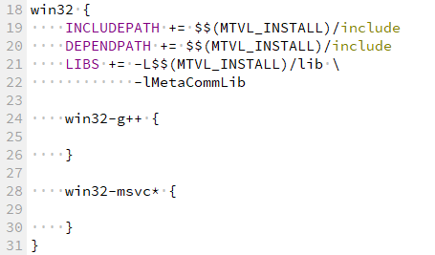

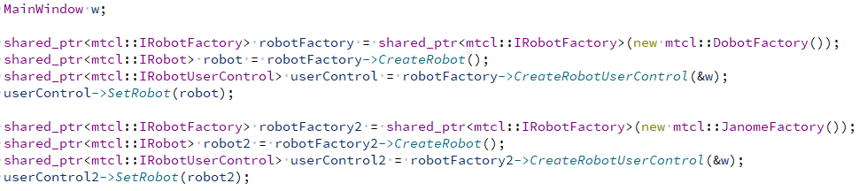

How to use
Add library to LIBS
Include headers
Instantiate concrete robot and UI by using appropriate factory
Add control to main page.

Slide 9
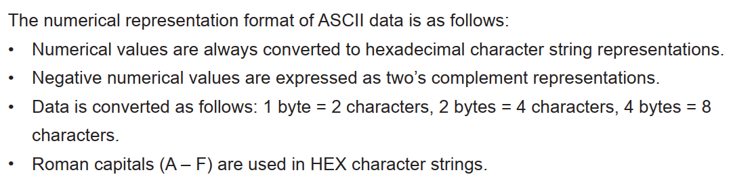
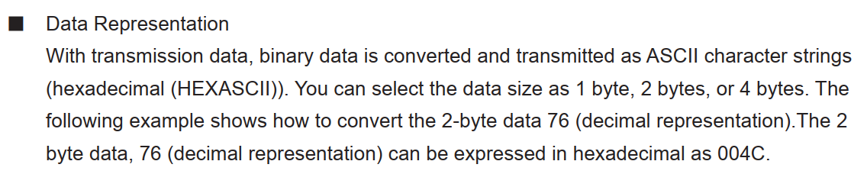
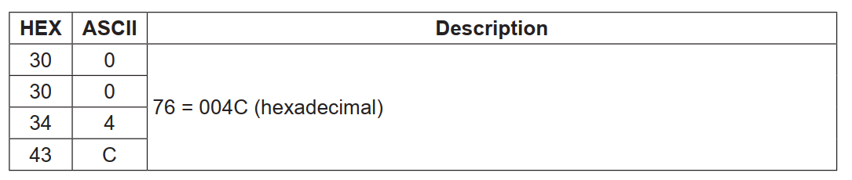
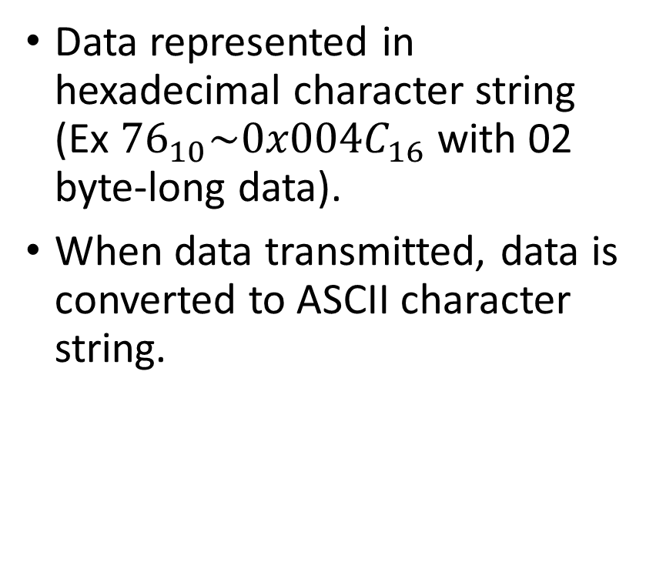
Note on Janome protocol
Data represented in hexadecimal character string (Ex ${76}_{10}\sim {0x004C}_{16}$ with 02 byte-long data).
When data transmitted, data is converted to ASCII character string.

Slide 10
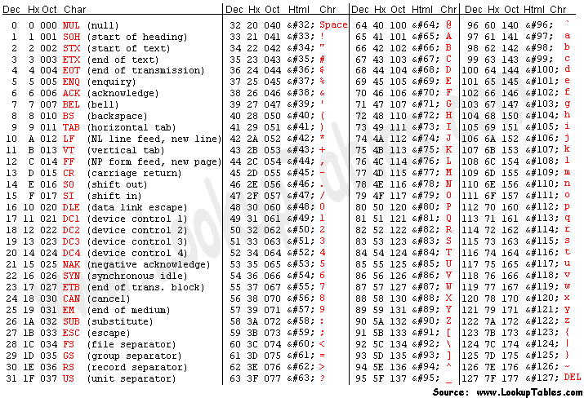

Note on Janome protocol
Step1: Convert the data to hexadecimal with pre-defined long
Ex. ${76}_{10}⇒{0x004C}_{16}$
Step2: Convert to ASCII hexadecimal string
Ex. ${0x004C}_{16}⇒30303443$
0x004C | 30303443
0 | 30
0 | 30
4 | 34
C | 43

Slide 11
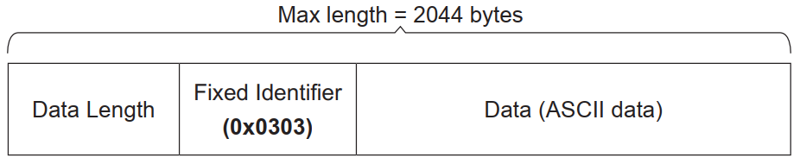
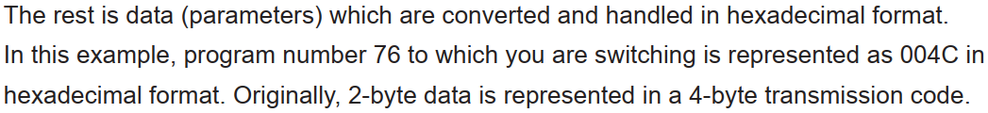
Note on Janome protocol
Data frame (Ethernet communication)
Data Length: 4-byte
Fixed Identifier: 2 byte (0x0303)
Data
Command: 1byte
Sub-Command: 1byte
Parameters (hexadecimal format): 2-byte data is represented in 4-byte transmission code

Slide 12
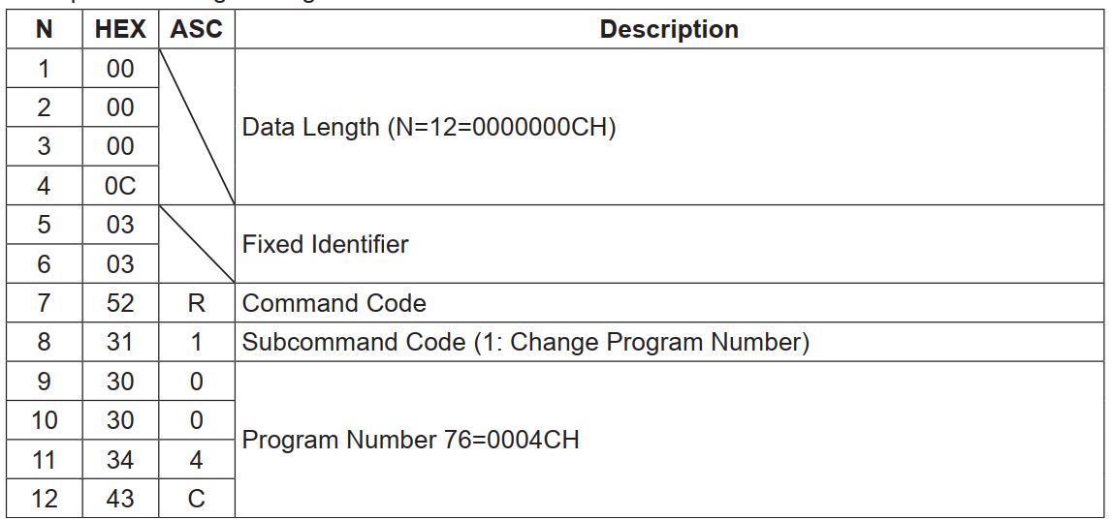
Note on Janome protocol

Slide 13
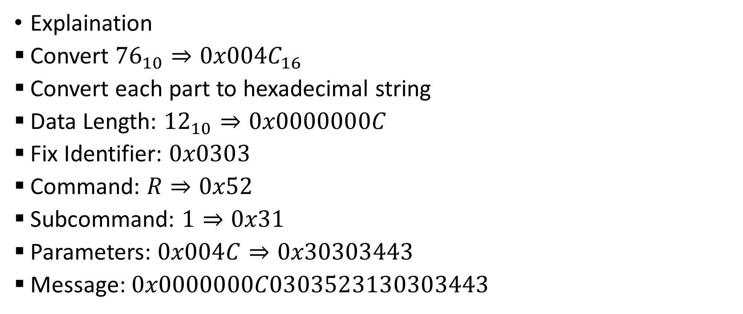
Note on Janome protocol
Explaination
Convert ${76}_{10}⇒{0x004C}_{16}$
Convert each part to hexadecimal string
Data Length: ${12}_{10}⇒0x0000000C$
Fix Identifier: $0x0303$
Command: $R⇒0x52$
Subcommand: $1⇒0x31$
Parameters: $0x004C⇒0x30303443$
Message: $0x0000000C0303523130303443$

